Slide 1
ROUTING PROTOCOLS
BY,
A.JOTHIMANI

Slide 2
RIP
The Routing Information Protocol (RIP) is an intra-domain (interior) routing protocol used inside an autonomous system.
It is a very simple protocol based on distance vector routing which employ the hop count as a routing metric.
RIP prevents routing loops by implementing a limit on the number of hops allowed in a path from source to destination.
The maximum number of hops allowed for RIP is 15, which limits the size of networks that RIP can support.
A hop count of 16 is considered an infinite distance and the route is considered unreachable.

Slide 3
RIP version 1
The original specification of RIP was published in 1988 and uses classful routing.
The periodic routing updates do not carry subnet information, lacking support for variable length subnet masks (VLSM).
This limitation makes it impossible to have different-sized subnets inside of the same network class.
In other words, all subnets in a network class must have the same size.
There is also no support for router authentication, making RIP vulnerable to various attacks.

Slide 4
RIPv1 Operation
RIP defines two types of messages.
Request Message
Response Message
When a RIP router comes online, it sends a broadcast Request Message on all of its RIP enabled interfaces. All the neighboring routers which receive the Request message respond back with the Response Message containing their Routing table.
The Response Message is also unnecessarily sent when the Update timer expires. On receiving the Routing table, the router processes each entry of the routing table as per the following rules

Slide 5
If there are no route entries matching the one received then the route entry is added to the routing table automatically, along with the information about the router from which it received the routing table.
If there are matching entries but the hop count metric is lower than the one already in its routing table, then the routing table is updated with the new route.
If there are matching entries but the hop count metric is higher than the one already in its routing table, then the routing entry is updated with hop count of 16 (infinite hop). The packets are still forwarded to the old route.

Slide 6
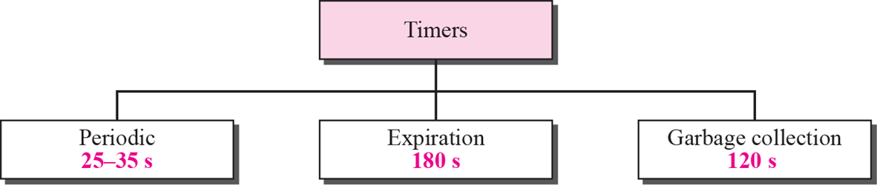
RIP Timer
Update Timer(Periodic)
The update timer controls the interval between two gratuitous Response Messages.
By default the value is 30 seconds. The response message is broadcast to all its RIP enabled interface.
Invalid Timer(Expiration)
The invalid timer specifies how long a routing entry can be in the routing table without being updated.
By default, the value is 180 seconds. After the timer expires the hop count of the routing entry will be set to 16, marking the destination as unreachable.

Slide 7
Flush Timer
The flush timer controls the time between the route is invalidated or marked as unreachable and removal of entry from the routing table.
By default the value is 240 seconds. This is 60 seconds longer than Invalid timer.
So for 60 seconds the router will be advertising about this unreachable route to all its neighbors. This timer must be set to a higher value than the invalid timer.
Hold-down Timer
The hold-down timer is started per route entry, when the hop count is changing from lower value to higher value. This allows the route to get stabilized. During this time no update can be done to that routing entry.

Slide 8
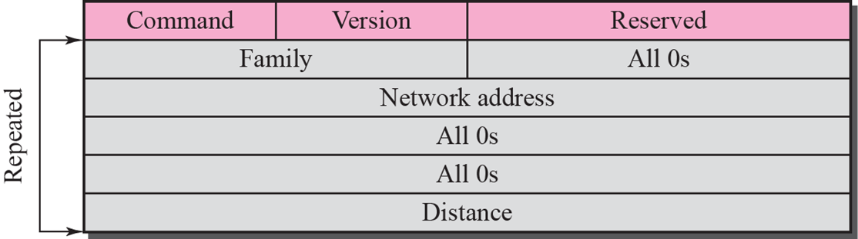
RIP message format

Slide 9
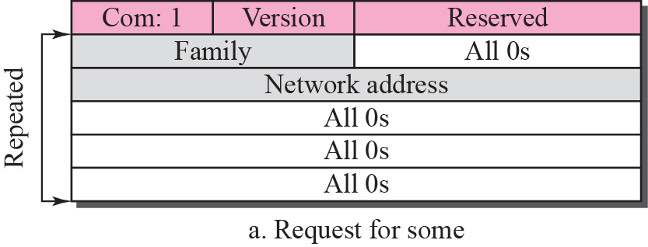
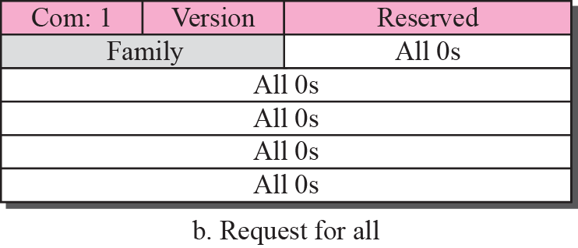
Request messages

Slide 10
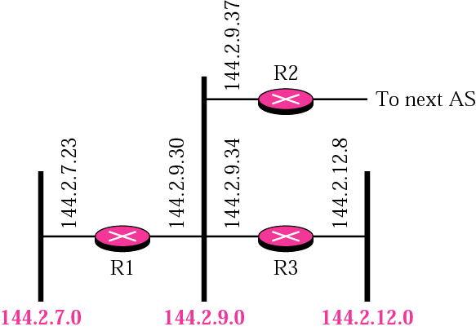
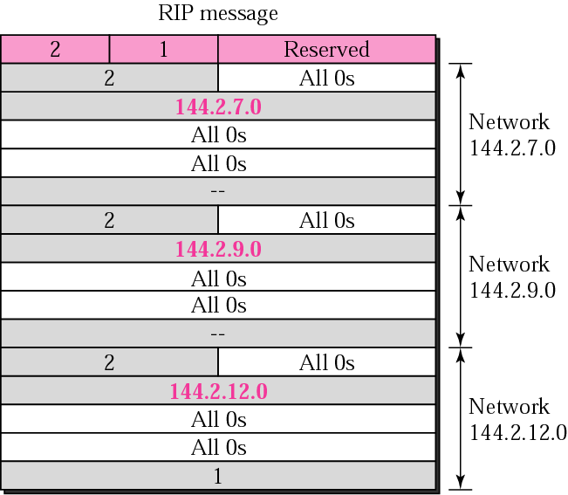
RIP message example

Slide 11
Limitations
The hop count cannot exceed 15, or routes will be dropped.
Most RIP networks are flat. There is no concept of areas or boundaries in RIP networks.
Variable Length Subnet Masks are not supported by RIP version 1 (which is obsolete).
RIP has slow convergence and count to infinity problems.

Slide 12
RIP Configuring and Commands
ip routing : enables the router
router rip : you can enter configuration commands to define the RIP process for router
network network_address : Telling the router which networks it should advertise routes for
write, write terminal : Saving configuration & view currently running configuration
ping address : To check and see if the packets are getting routed
show ip route : To view the routers current routing table
show ip rip : Gives information about RIP

Slide 13
RIP version 2
Due to the deficiencies of the original RIP specification, RIP version 2 (RIPv2) was developed in 1993 and last standardized in 1998. It included the ability to carry subnet information, thus supporting Classless Inter-Domain Routing (CIDR). To maintain backward compatibility, the hop count limit of 15 remained.
In an effort to avoid unnecessary load on hosts that do not participate in routing, RIPv2 multicasts the entire routing table to all adjacent routers at the address 224.0.0.9, as opposed to RIPv1 which uses broadcast. Unicast addressing is still allowed for special applications.

Slide 14
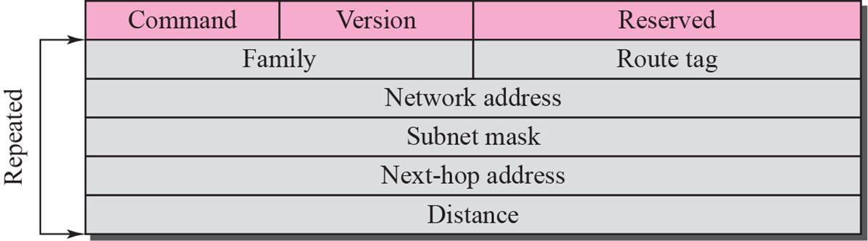
RIP version 2 format
Route tags were also added in RIP version 2. This functionality allows a distinction between routes learned from the RIP protocol and routes learned from other protocols.

Slide 15
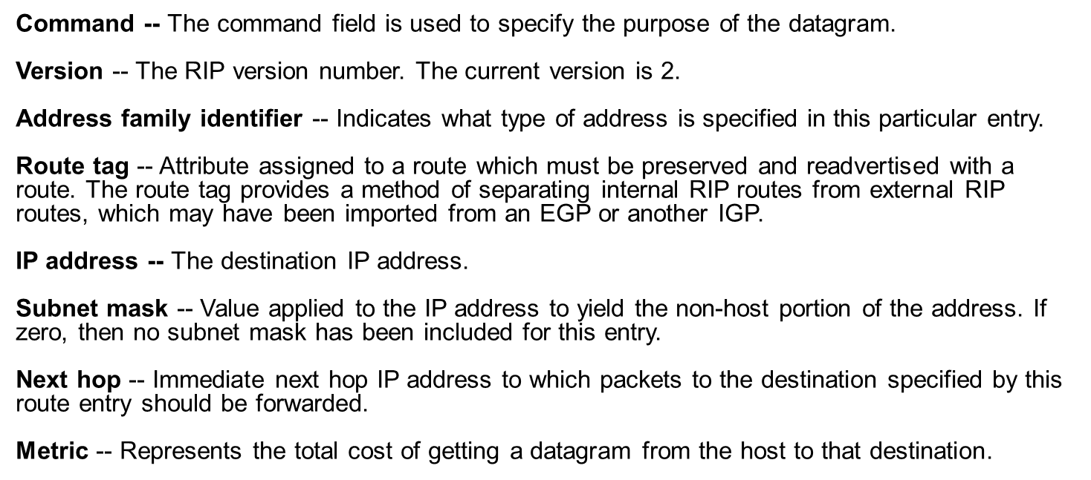

Slide 16
Limitations
RIP-2 supports generic notion of authentication, but only “password” is defined so far. Still not very secure.
RIP2 packet size increases as the number of networks increases hence it is not suitable for large networks.
RIP2 generates more protocol traffic than OSPF, because it propagates routing information by periodically transmitting the entire routing table to neighbor routers
RIP2 may be slow to adjust for link failures.

Slide 17
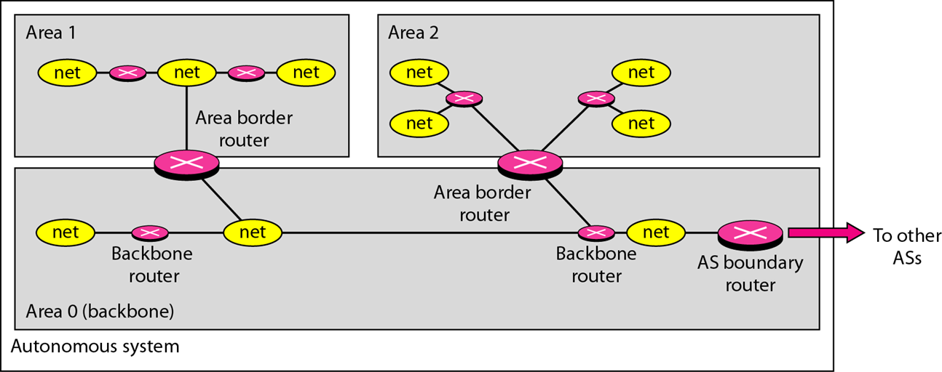
OSPF
The Open Shortest Path First (OSPF) protocol is an intra-domain routing protocol based on link state routing

Slide 18
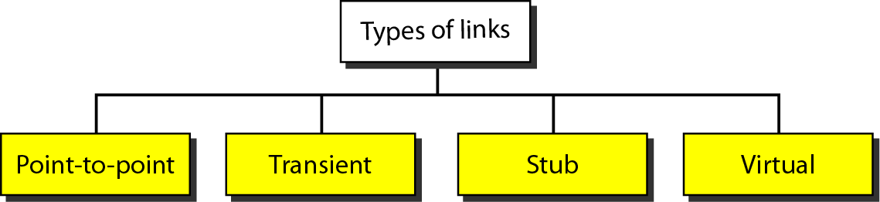
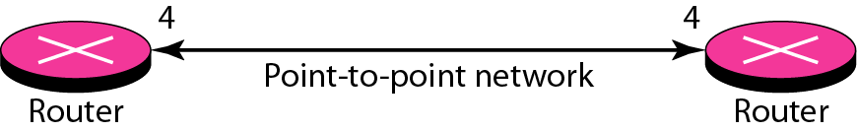
Types of links
Point-to-point link
It connects two routers without any other host or router

Slide 19
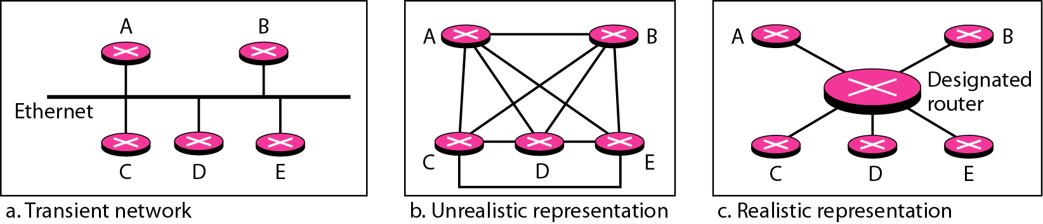

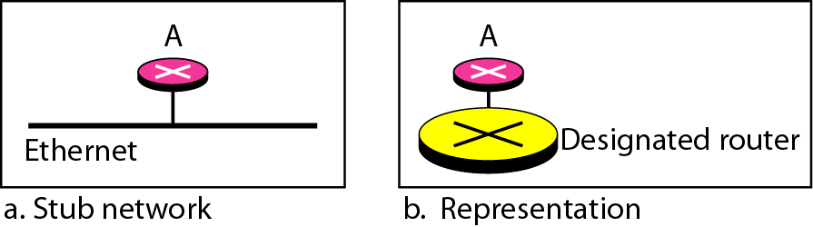
Transient link
It is a network with several routers attached to it.
It is a network that is connected to only one router.

Slide 20
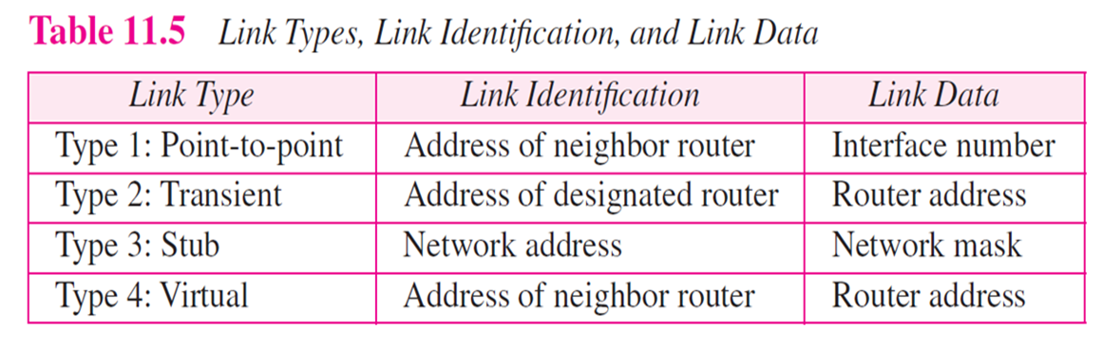
Virtual link
When the link between two routers is broken, the administration may create a virtual link between them.

Slide 21
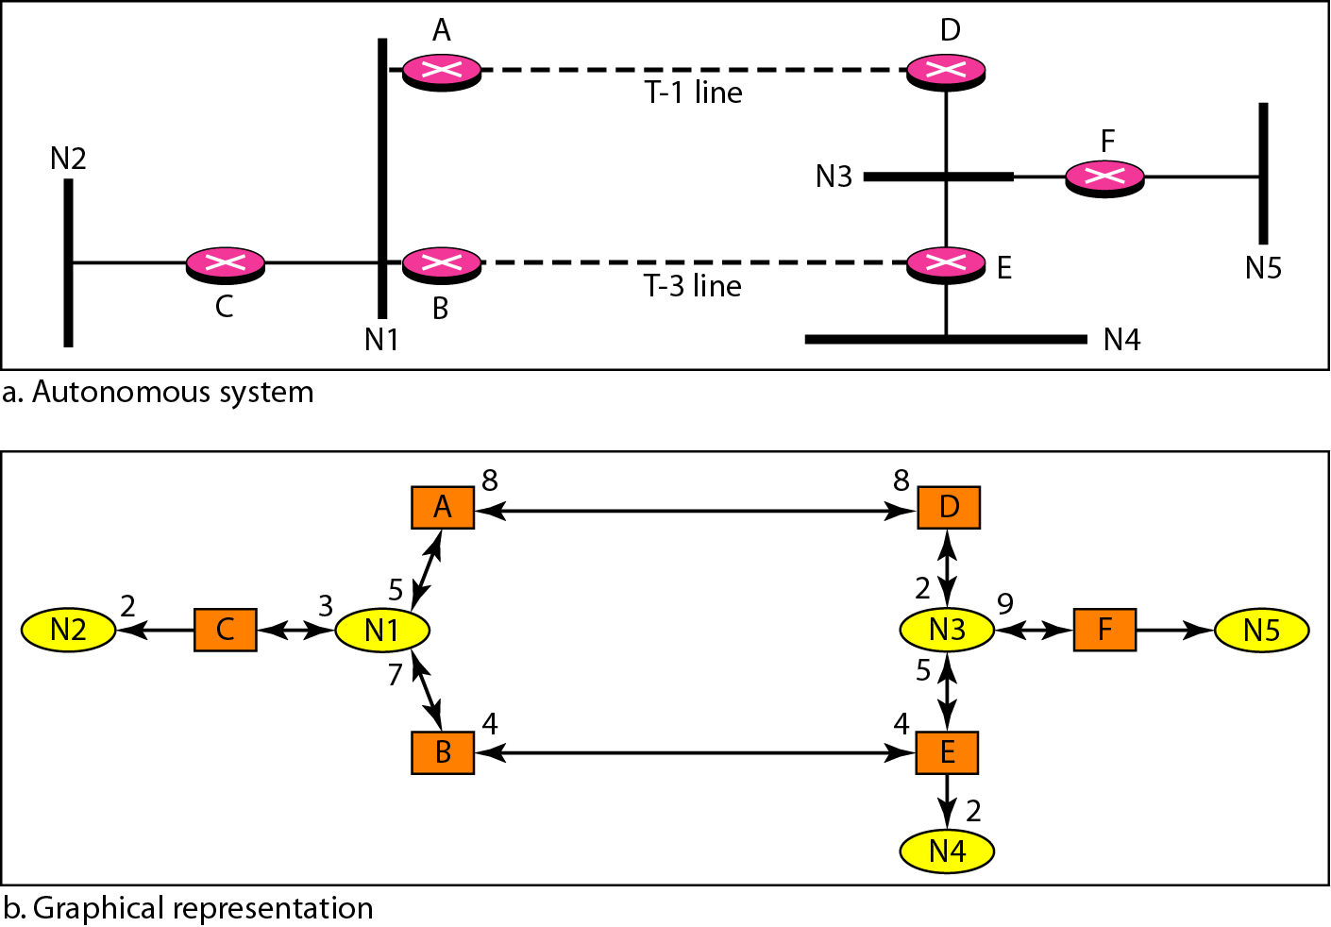
Example of an AS and its graphical representation in OSPF

Slide 22
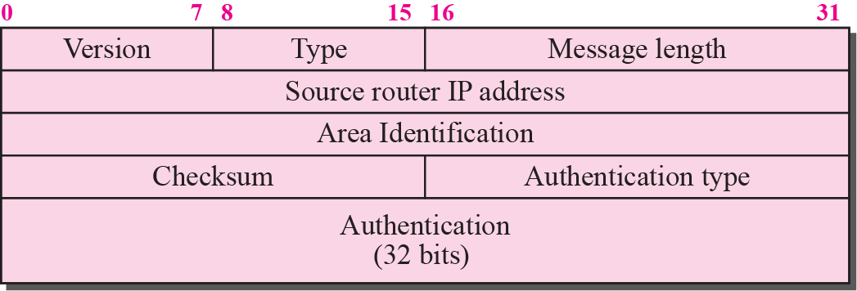
OSPF common header

Slide 23
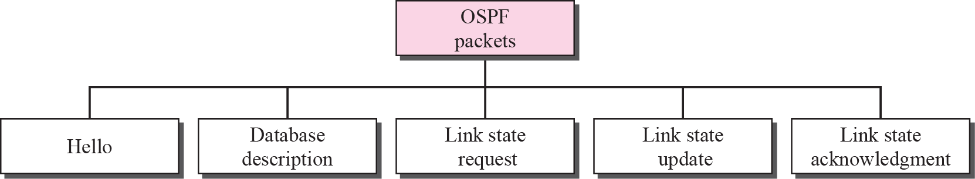
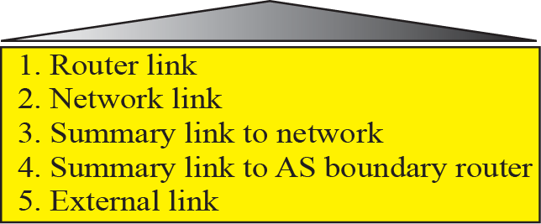
Types of OSPF packet

Slide 24
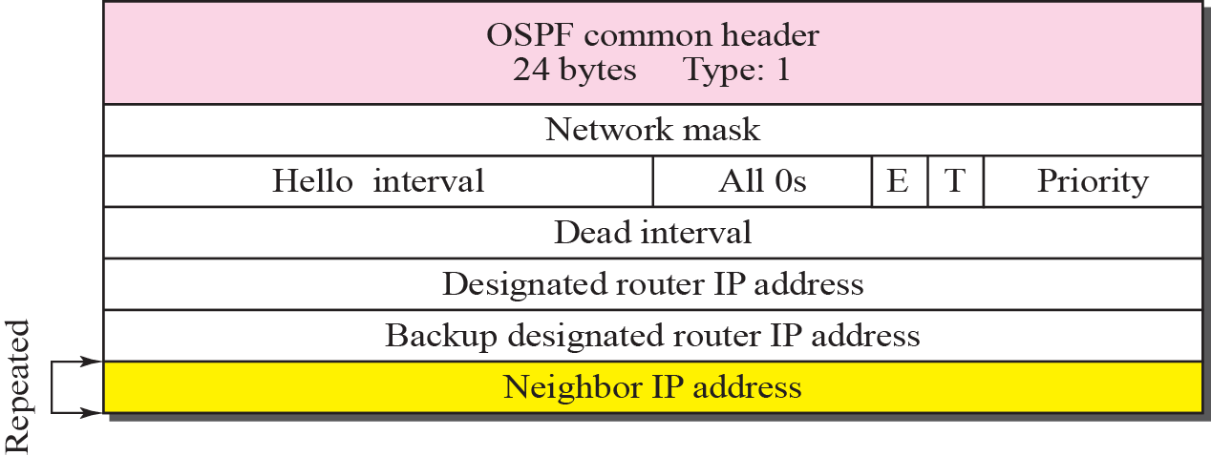
Hello packet
OSPF uses the hello message to create neighborhood relationship and to test the reachability of neighbors.
This is the first step in link state routing. Before a router can flood all of the other routers with information about its neighbors, it must first greet it neighbors.

Slide 25
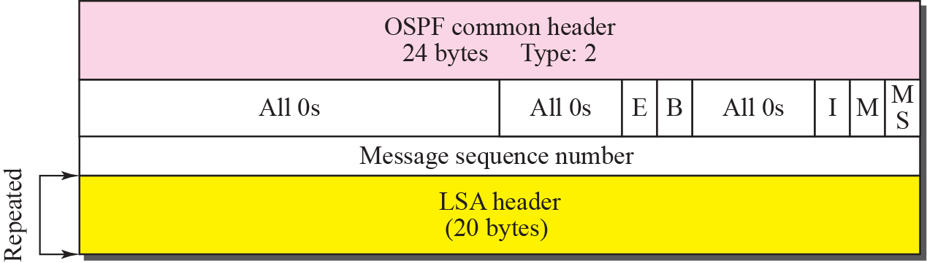
Database description packet
When a router is connected to the system for the first time or after a failure, it needs the complete link state database immediately. Therefore, it sends hello packets to greet its neighbors. If this is the first time that the neighbors hear from the router, they send a database description message.
The database description packet does not contain complete database information; it only gives an outline, the title of each lines in the database.

Slide 26
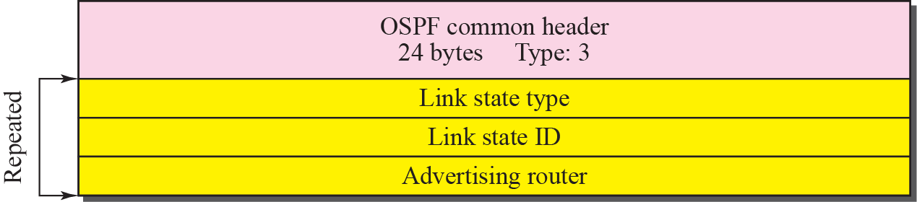
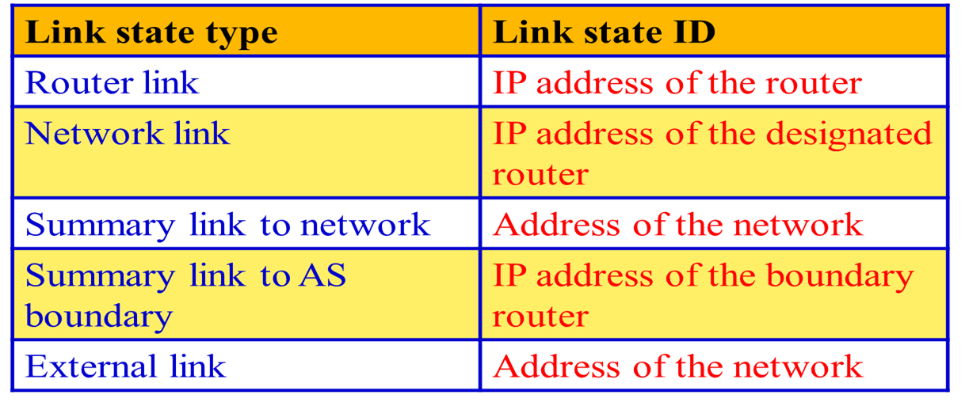
Link state request packet

Slide 27
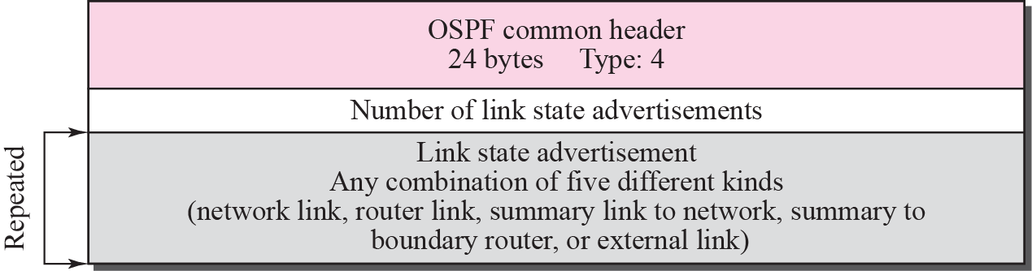
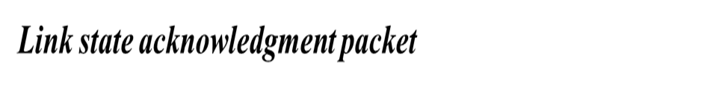
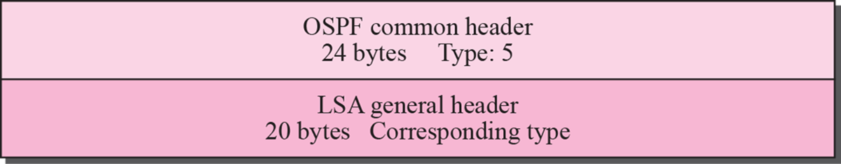
Link state update packet

Slide 28
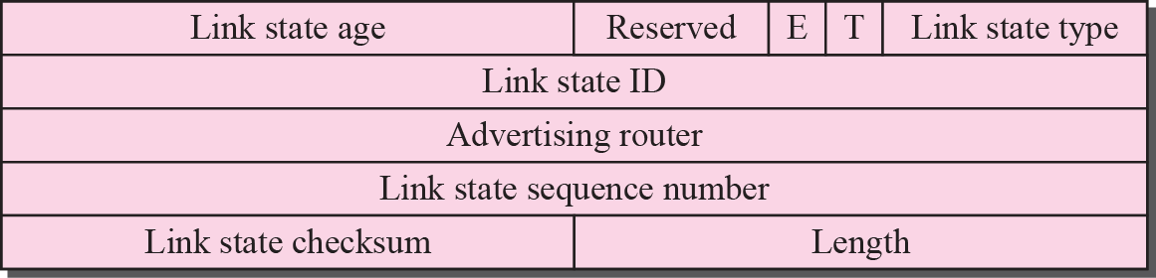
LSA general header

Slide 29
LSA General Header
Link state age
When a router creates the message, the value of this field is 0
When each successive router forwards this message, it estimates the transit time and adds it to the cumulative value of this field
E flag
If this flag is set to 1, it means the area is a stub area (an area that is connected to the backbone area by only one path
T flag
If this flag is set to 1, it means the router can handle multiple types of services
Advertising router
The IP address of the router advertising this message
Link state sequence number
A sequence number assigned to each link state update message

Slide 30
EIGRP
“
Enhanced” Interior Gateway Routing Protocol
Cisco proprietary, released in 1994
Developed from the older IGRP (classful)
EIGRP is classless, supports VLSM, CIDR
EIGRP is an advanced distance-vector routing protocol that relies on features commonly associated with link-state protocols. (sometimes called a hybrid routing protocol).
RIP, IGRP, EIGRP
RIP is a typical distance vector routing protocol enhancements for better performance using hop count as metric, max 15.
IGRP was introduced to have a better metric and not be restricted to 15 hops. It is a typical distance vector routing protocol, and classful.
EIGRP was introduced to be classless and with maximum no of hops.

Slide 31
IGRP EIGRP
Bellman-Ford algorithm
Ages out routing entries
Sends periodic updates
Keeps best routes only
Slow convergence with holddown timers
Diffusing Update Algorithm (DUAL)
Does not age out entries
No periodic updates
Keeps backup routes
Faster convergence, no holddown timers

Slide 32
IGRP and EIGRP: A migration path
IGRP | EIGRP
Classful Routing Protocol | Classless Routing Protocol VLSM, CIDR
bandwidth = (10,000,000/bandwidth kbps) delay = delay/10 24 bit metric for bandwidth and delay | bandwidth = (10,000,000/bandwidth kbps) * 256 delay = (delay/10) * 256 32 bit metric for bandwidth and delay
Maximum Hop Count = 255 | Maximum Hop Count = 224
No differentiation between internal and external routes. | Outside routes (redistributed) are tagged as external routes.
Automatic redistribution between IGRP and EIGRP as long as “AS” numbers are the same.

Slide 33
Encapsulation
Frame header
IP packet header
EIGRP packet header
Type/ length/ value data
If Ethernet, destination MAC address multicast 01-00-5E-00-00-0A.
Opcode AS number
EIGRP Parameters, IP Internal Routes, IP External Routes.
Protocol field 88 destination address multicast 224.0.0.10.

Slide 34
EIGRP packet header
EIGRP packet header
Opcode specifies packet type: Update, Query, Reply, Hello
Autonomous system (AS) number specifies the EIGRP process. Several can run at the same time.
Other fields allow for reliability if needed.

Slide 35
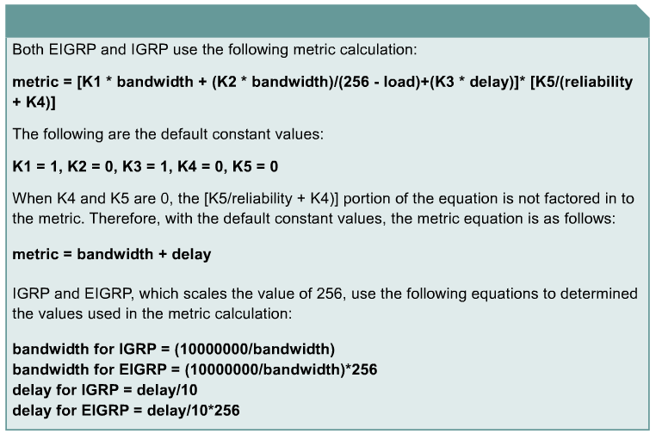
Metric Calculation (Review)
k1 for bandwidth
k2 for load
k3 for delay
k4 and k5 for Reliability
Router(config-router)# metric weights tos k1 k2 k3 k4 k5
EIGRP
bandwidth is in kbps

Slide 36
Features of EIGRP
Classless Routing Protocol (VLSM, CIDR)
Faster convergence times and improved scalability
Rapid Convergence and Better handling of routing loops – (DUAL) (coming)
Efficient Use of Bandwidth
Partial, bounded updates: Incremental updates only to the routers that need them.
Minimal bandwidth consumption: Uses Hello packets and EIGRP packets by default use no more that 50% of link’s bandwidth EIGRP packets.
PDM (Protocol Dependent Module)
Keeps EIGRP is modular
Different PDMs can be added to EIGRP as new routed protocols are enhanced or developed: IPv4, IPv6, IPX, and AppleTalk

Slide 37

Hello packets
Used by EIGRP to discover neighbours
Used to form adjacencies with neighbours.
Multicasts
Unreliable delivery
Hello
Hello

Slide 38
Update packets
Used to propagate routing information.
No periodic updates.
Sent only when necessary.
Include only required information
Sent only to those routers that require it.
Reliable delivery.
Multicast if to several routers, unicast if to one router.

Slide 39
Update packets
EIGRP updates are sent only when a route changes.
EIGRP updates are partial. They include only information about the changed route.
EIGRP updates are bounded. They go only to routers that are affected by the change.
This keeps updates small and saves bandwidth.

Slide 40
Acknowledgement (ACK) packets
Sent when reliable delivery is used by RTP.
Sent in response to update packets.
Unreliable delivery
Unicast
Update (reliable)
ACK (unreliable)

Slide 41
Query packet
Used when searching for a network
E.g. a route goes down. Is there another route?
Uses reliable delivery so requires ACK
Multicast or unicast
All neighbours must reply
Query (reliable)
ACK (unreliable)

Slide 42
Reply packet
Sent in response to a query from a neighbour.
Sent reliably so requires ACK.
Unicast
Query (reliable)
ACK (unreliable)
Reply (reliable)
ACK (unreliable)

Slide 43
Summary of message types
 | Unicast | Multicast | Either
Reliable | Reply |  | Update Query
Unreliable | ACK | Hello

Slide 44
EIGRP Terminology
Neighbor table – Each EIGRP router maintains a neighbor table that lists adjacent routers. This table is comparable to the adjacency database used by OSPF. There is a neighbor table for each protocol that EIGRP supports.
Topology table – Every EIGRP router maintains a topology table for each configured network protocol. This table includes route entries for all destinations that the router has learned. All learned routes to a destination are maintained in the topology table.
Routing table – EIGRP chooses the best routes to a destination from the topology table and places these routes in the routing table. Each EIGRP router maintains a routing table for each network protocol.

Slide 45
Successor – A successor is a route selected as the primary route to use to reach a destination. Successors are the entries kept in the routing table. Multiple successors for a destination can be retained in the routing table.
Feasible successor – A feasible successor is a backup route. These routes are selected at the same time the successors are identified, but are kept in the topology table. Multiple feasible successors for a destination can be retained in the topology table.

Slide 46
Neighbor Table
Whenever a new neighbor is discovered, the address of that neighbor and the interface used to reach it are recorded in a new neighbor table entry.
RouterC#show ip eigrp neighbors
IP-EIGRP neighbors for process 44
H Address Interface Hold Uptime SRTT RTO Q Seq
(sec) (ms) Cnt Num
0 192.168.0.1 Se0 11 00:03:09 1138 5000 0 6
1 192.168.1.2 Et0 12 00:34:46 4 200 0 4

Slide 47
Neighbor Table
RouterC#show ip eigrp neighbors
IP-EIGRP neighbors for process 44
H Address Interface Hold Uptime SRTT RTO Q Seq
(sec) (ms) Cnt Num
0 192.168.0.1 Se0 11 00:03:09 1138 5000 0 6
1 192.168.1.2 Et0 12 00:34:46 4 200 0 4
Neighbor address The network-layer address of the neighbor router(s).
Queue count The number of packets waiting in queue to be sent. If this value is constantly higher than zero, then there may be a congestion problem at the router. A zero means that there are no EIGRP packets in the queue.

Slide 48
Neighbor Table
RouterC#show ip eigrp neighbors
IP-EIGRP neighbors for process 44
H Address Interface Hold Uptime SRTT RTO Q Seq
(sec) (ms) Cnt Num
0 192.168.0.1 Se0 11 00:03:09 1138 5000 0 6
1 192.168.1.2 Et0 12 00:34:46 4 200 0 4
Smooth Round Trip Timer (SRTT) The average time it takes to send and receive packets from a neighbor.
This timer is used to determine the retransmit interval (RTO)
Hold Time The interval to wait without receiving anything from a neighbor before considering the link unavailable.
Originally, the expected packet was a hello packet, but in current Cisco IOS software releases, any EIGRP packets received after the first hello will reset the timer.

Slide 49
Topology Table
EIGRP uses its topology table to store all the information it needs to calculate a set of distances and vectors to all reachable destinations.
RouterB#show ip eigrp topology
IP-EIGRP Topology Table for process 44
Codes: P - Passive, A - Active, U - Update, Q - Query, R - Reply, r - Reply status
P 206.202.17.0/24, 1 successors, FD is 2195456
via 206.202.16.1 (2195456/2169856), Ethernet0
P 206.202.18.0/24, 2 successors, FD is 2198016
via 192.168.0.2 (2198016/284160), Serial0
via 206.202.16.1 (2198016/2172416), Ethernet0

Slide 50
Topology Table
RTX#sh ip eigrp top 204.100.50.0
IP-EIGRP topology entry for 204.100.50.0/24
State is Passive, Query origin flag is 1, 1 Successor(s), FD is 2297856
Routing Descriptor Blocks:
10.1.0.1 (Serial0), from 10.1.0.1, Send flag is 0x0
Composite metric is (2297856/128256), Route is External
Vector metric:
Minimum bandwidth is 1544 Kbit
Total delay is 25000 microseconds
Reliability is 255/255
Load is 1/255
Minimum MTU is 1500
Hop count is 1
External data:
Originating router is 192.168.1.1
AS number of route is 0
External protocol is Connected, external metric is 0
Administrator tag is 0 (0x00000000)
FD/RD

Slide 51
IP Routing Table
EIGRP chooses the best routes (that is, successor) to a destination from the topology table and places these routes in the routing table.
Each EIGRP router maintains a topology table for each network protocol.
EIGRP displays both internal EIGRP routes and external EIGRP routes.
RouterB#show ip route
Codes: C - connected, S - static, I - IGRP, R - RIP, M - mobile, B - BGP
D - EIGRP, EX - EIGRP external, O - OSPF, IA - OSPF inter area
E1 - OSPF external type 1, E2 - OSPF external type 2, E - EGP
i - IS-IS, L1 - IS-IS level-1, L2 - IS-IS level-2, * - candidate default U - per-user static route
Gateway of last resort is not set
C 10.1.1.0 is directly connected, Serial0
D 172.16.0.0 [90/2681856] via 10.1.1.0, Serial0
D EX 192.168.1.0 [170/2681856] via 10.1.1.1, 00:00:04, Serial0

Slide 52
IP Routing Table
The routing table contains the routes installed by DUAL as the best loop-free paths to a given destination.
EIGRP will maintain up to four routes per destination.
These routes can be of equal, or unequal cost (if using the variance command). (later)
RouterB#show ip route
Codes: C - connected, S - static, I - IGRP, R - RIP, M - mobile, B - BGP
D - EIGRP, EX - EIGRP external, O - OSPF, IA - OSPF inter area
E1 - OSPF external type 1, E2 - OSPF external type 2, E - EGP
i - IS-IS, L1 - IS-IS level-1, L2 - IS-IS level-2, * - candidate default U - per-user static route
Gateway of last resort is not set
C 10.1.1.0 is directly connected, Serial0
D 172.16.0.0 [90/2681856] via 10.1.1.0, Serial0
D EX 192.168.1.0 [170/2681856] via 10.1.1.1, 00:00:04, Serial0

Slide 53
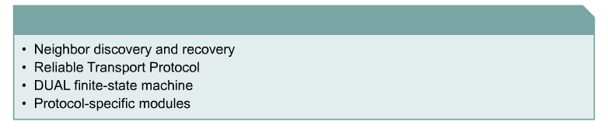
EIGRP Technologies
Four key technologies set EIGRP apart from IGRP

Slide 54
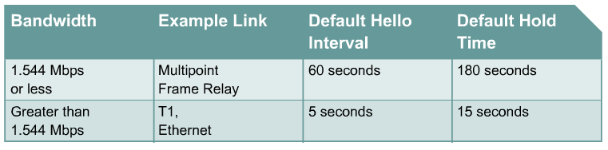
Hello Intervals and Default Hold Times
Hello Time The interval of Hello Packets
Hold Time The interval to wait without receiving anything from a neighbor before considering the link unavailable.

Slide 55
DUAL FSM
The centerpiece of EIGRP is DUAL, the EIGRP route-calculation engine.
The full name of this technology is DUAL finite state machine (FSM).
This engine contains all the logic used to calculate and compare routes in an EIGRP network.
What is FSM?
An FSM is an abstract machine, not a mechanical device with moving parts.
FSMs define a set of possible states something can go through, what events causes those states, and what events result from those states.
Designers use FSMs to describe how a device, computer program, or routing algorithm will react to a set of input events.

Slide 56

FSM Example
States such as Passive and Active trigger Certain Events

Slide 57
DUAL FSM
DUAL selects alternate routes quickly by using the information in the EIGRP tables.
If a link goes down, DUAL looks for a feasible successor in its neighbor and topology tables.
A successor is a neighboring router that is currently being used for packet forwarding, provides the least-cost route to the destination, and is not part of a routing loop.
Feasible successors provide the next lowest-cost path without introducing routing loops.
Feasible successor routes can be used in case the existing route fails; packets to the destination network are immediately forwarded to the feasible successor, which at that point, is promoted to the status of successor.
Selects a best loop-free path to a destination, the next hop being known as the successor.
All other routers to the same destination, that also meet the feasible condition, meaning they are also loop-free (later), become feasible successors, or back-up routes.
debug eigrp fsm

Slide 58
What if the successor fails?
Feasible Successor exists:
If current successor route fails, feasible successor becomes the current successor, i.e. the current route.
Routing of packets continue with little delay.
No Feasible Successor exists:
This may be because the Reported Distance is greater than the Feasible Distance.
Before this route can be installed, it must be placed in the active state and recomputed.
Routing of packets continue but with more of a delay.

Slide 59
BGP
Border Gateway Protocol (BGP) is an interdomain routing protocol using path vector routing. It first appeared in 1989 and has gone through four versions.
Types of AS:
Stub AS
A stub AS has only one connection to another AS.
The interdomain data traffic in a stub AS can be either created or terminated in the AS.
The host in the AS can send/Receive data traffic/coming form other ASs.
Data traffic cannot pass through a stub AS. A stub AS is either a source or a sink.

Slide 60
2. Multihomed AS
It has more than one connection to other ASs, but it is still only a source or a sink.
It can send/receive data traffic from/to more than one AS.
It does not allow data coming from one AS and going to another AS to pass through.
3. Transit AS
It allows transient traffic.

Slide 61
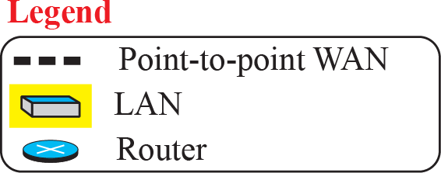
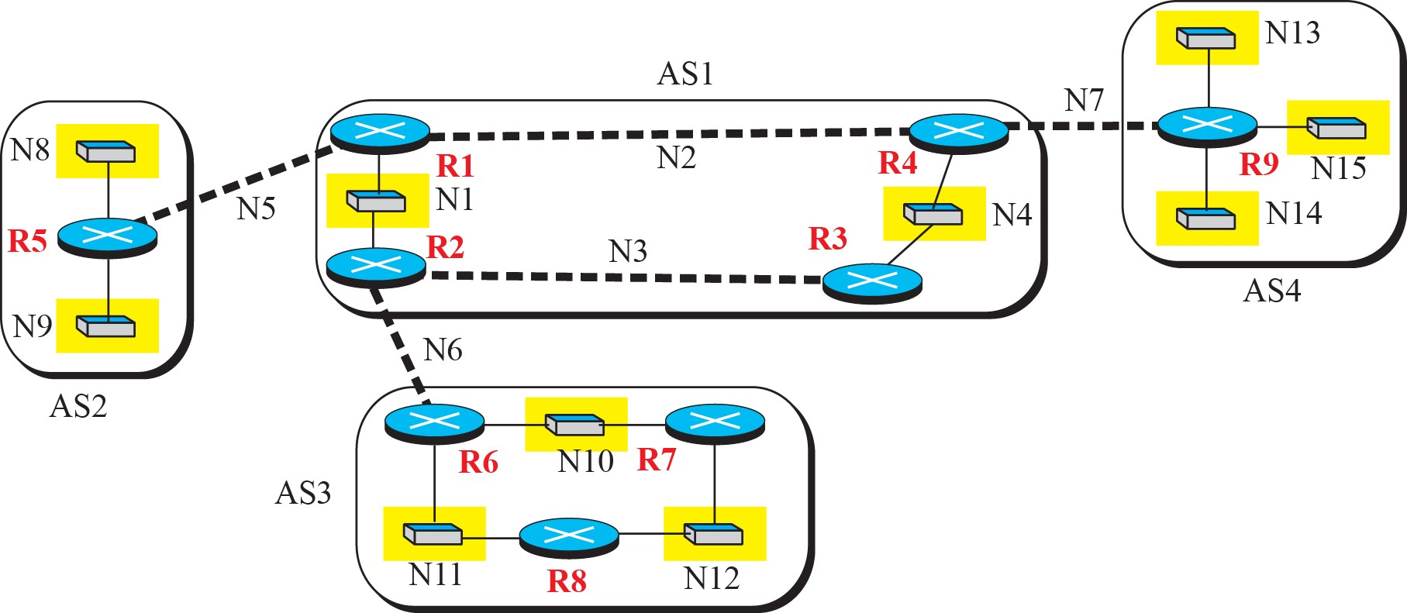
A sample internet with 4 AS’s

Slide 62
External and Internal BGP
If we want to be precise, BGP can have two types of sessions: external BGP (E-BGP) and internal BGP (I-BGP) sessions.
The E-BGP session is used to exchange information between two speaker nodes belonging to two different autonomous systems.
The IBGP session is used to exchange routing information between two routers inside an autonomous system.
The session established between AS1 and AS2 is an E-BGP session. The two speaker routers exchange information they know about networks in the Internet.
However, these two routers need to collect information from other routers in the autonomous systems. This is done using I-BGP sessions.

Slide 63
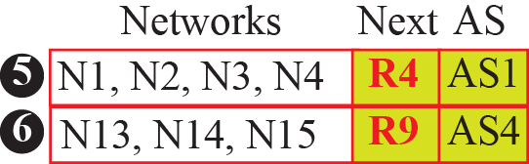
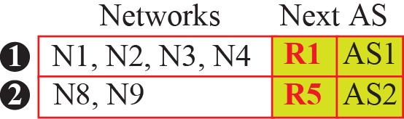
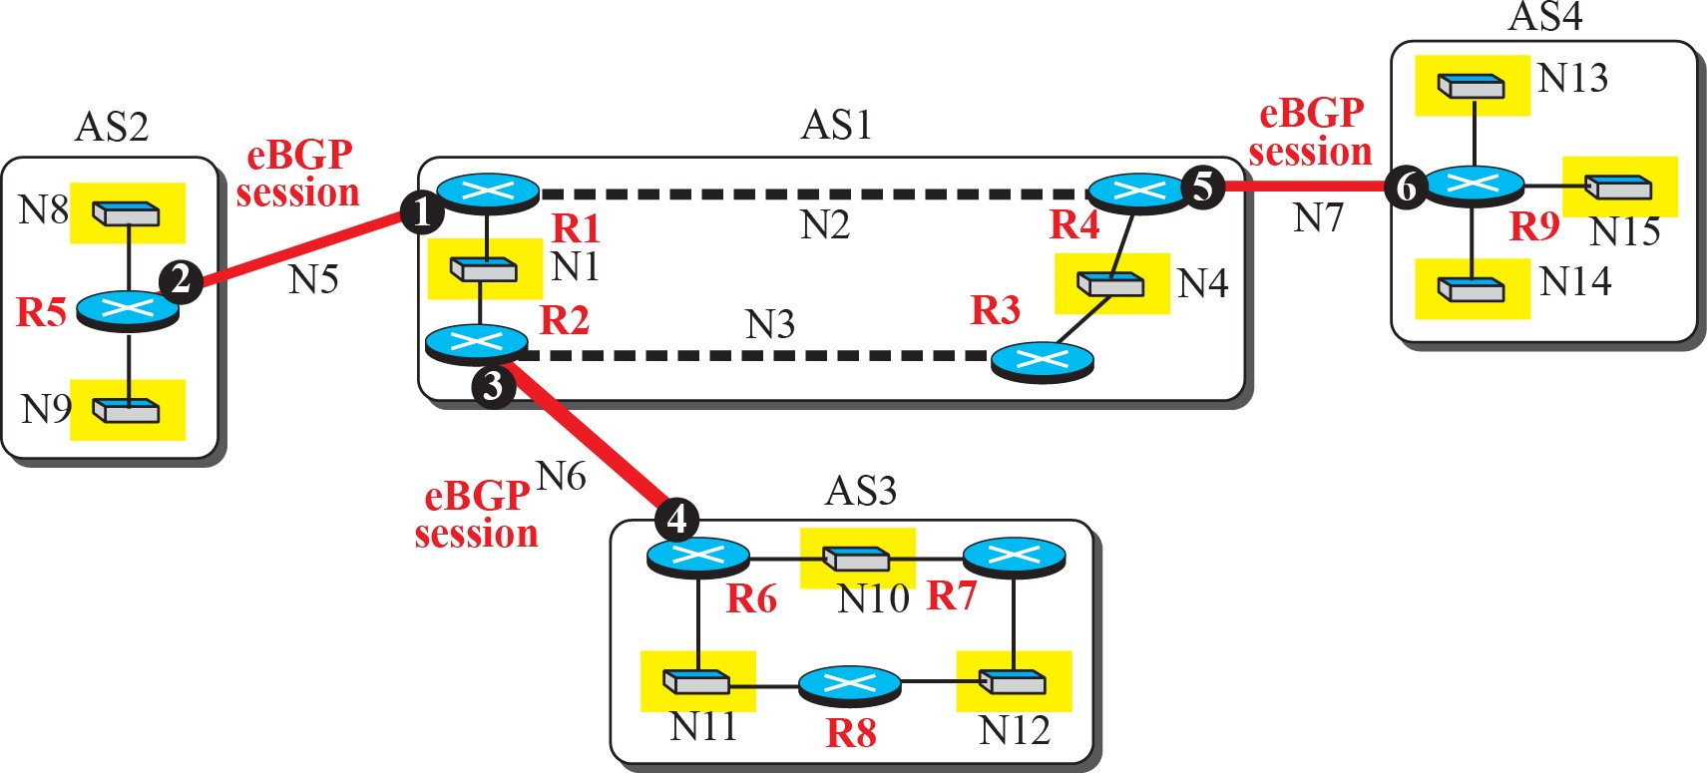
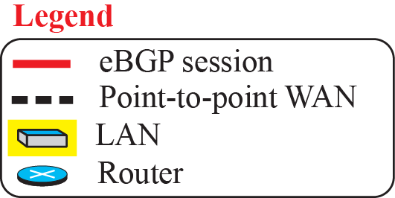
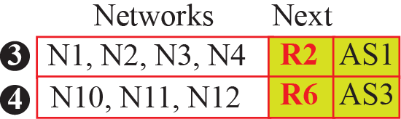
eBGP operation

Slide 64
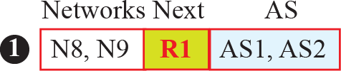
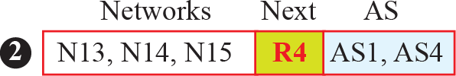
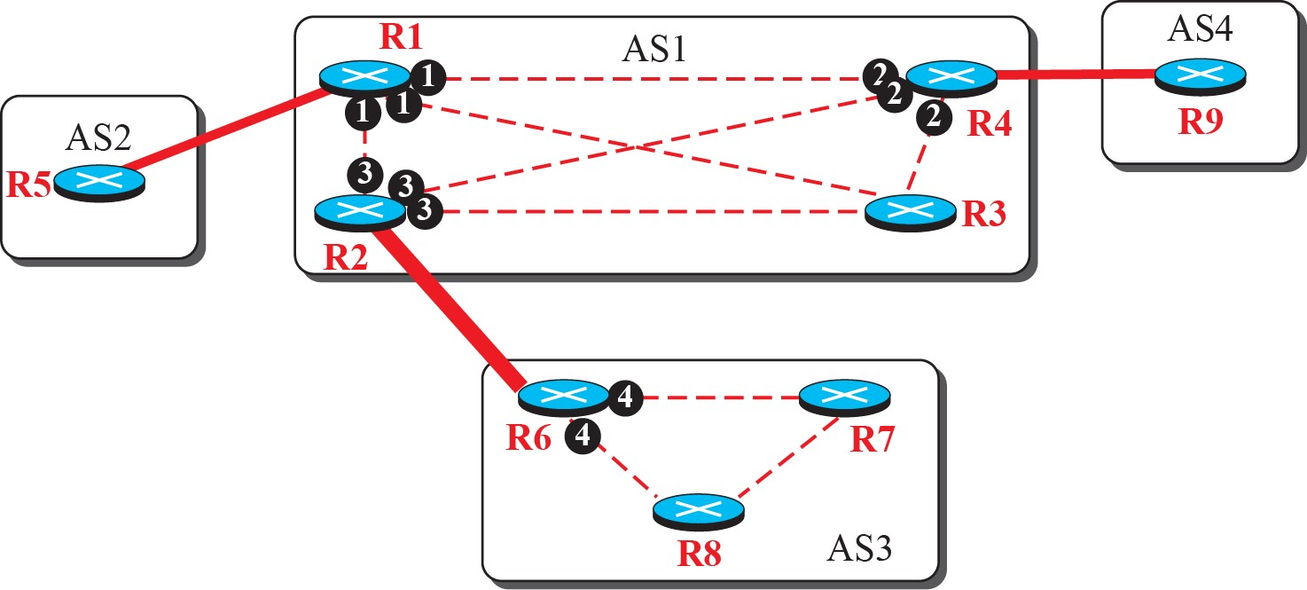
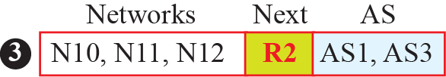
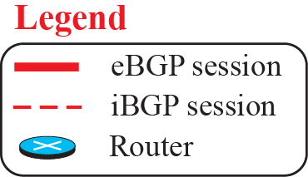
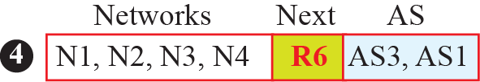
Combination of eBGP and iBGP sessions in our internet

Slide 65
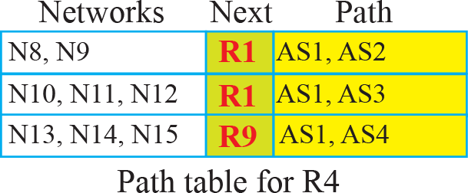
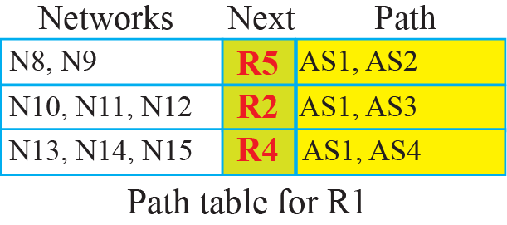
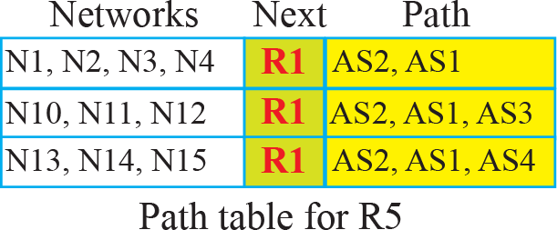
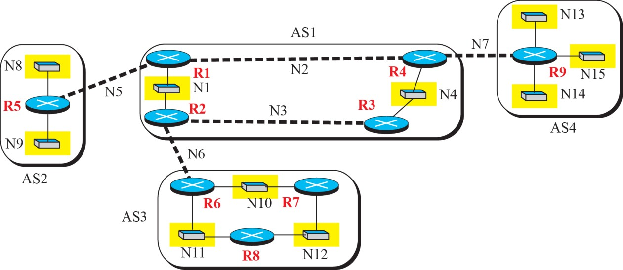
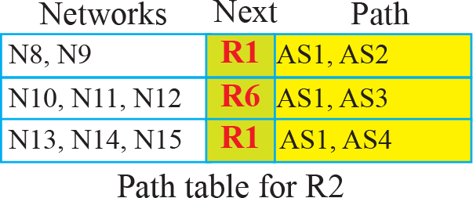
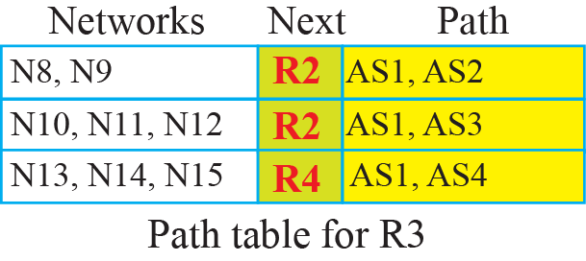
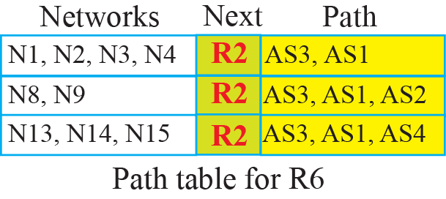

Slide 66
Attributes
Well known
Optional
Mandatory
Discretionary
Transitive
Non Transitive
Path attributes
The path was presented as a list of attributes. Each attribute give some information about the path.
The list of attributes helps the receiving router make a more informed decision when applying its policy.

Slide 67
Well Known- one that every BGP router must recognize.
Optional- one that needs not be recognized by every router.
Well known mandatory- one that must appear in the description of a route.
Well known Discretionary- one that must be recognized by each router.
Optional Transitive – one that must be passed to the next router by the router that has not implemented this attribute
Optional Non Transitive – one that must be discarded if the receiving router has not implemented.

Slide 68
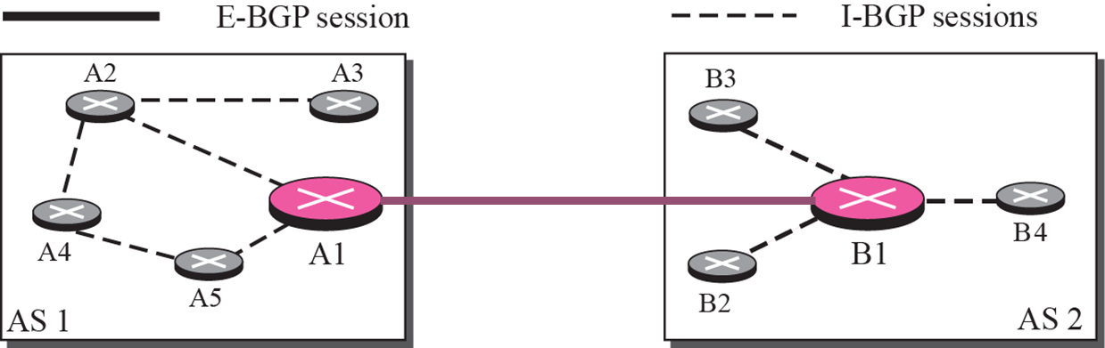
BGP Sessions
The exchange of routing information between two routers using BGP takes place in a session.
A session is a connection that is established between two BGP routers only for the sake of exchanging routing information.
To create a reliable environment, BGP uses the services of TCP.
When a TCP connection is created for BGP, it can last for a long time, until something unusual happens.
For this reason, BGP sessions are sometimes referred to as semi permanent connections.

Slide 69



Types of BGP messages

Slide 70
Packet Format
All BGP packets share the same common header.
The fields of this header are as follows:
❑ Marker. The 16-byte marker field is reserved for authentication.
❑ Length. This 2-byte field defines the length of the total message including the header.
❑ Type. This 1-byte field defines the type of the packet.

Slide 71

Open message
To create a neighborhood relationship, a router running BGP opens a TCP connection with a neighbor and sends an open message. If the neighbor accepts the neighborhood relationship, it responds with a keep alive message, which means that a relationship has been established between the two routers.
❑ Hold time. This 2-byte field defines the maximum number of seconds that can elapse until one of the parties receives a keepalive or update message from the other. If a router does not receive one of these messages during the hold time period, it considers the other party dead.

Slide 72
BGP identifier. This 4-byte field defines the router that sends the open message. The router usually uses one of its IP addresses (because it is unique) for this purpose.
Option length. The open message may contain some option parameters. In this case, this 1-byte field defines the length of the total option parameters. If there are no option parameters, the value of this field is zero.
Option parameters. If the value of the option parameter length is not zero, it means that there are some option parameters. Each option parameter itself has two subfields: the length of the parameter and the parameter value. The only option parameter defined so far is authentication.

Slide 73

Update message
The update message is the heart of the BGP protocol. It is used by a router to withdraw destinations that have been advertised previously, announce a route to a new destination, or both..

Slide 74
Unfeasible routes length. This 2-byte field defines the length of the next field.
Withdrawn routes. This field lists all the routes that must be deleted from the previously advertised list.
Path attributes length. This 2-byte field defines the length of the next field.
Network layer reachability information (NLRI). This field defines the network that is actually advertised by this message. It has a length field and an IP address prefix. The length defines the number of bits in the prefix. The prefix defines the common part of the network address

Slide 75


Keepalive message
Notification message
A notification message is sent by a router whenever an error condition is detected or a router wants to close the connection

